Slide 1
Advanced Topics Overview
Avanade ASG Data Science Bootcamp

Slide 2
Agenda
1
2
3
4
5
6
Computer Vision
7
Model Interpretability
Sebastian
Sahana
Natural Language Processing
Nesli
Graph Neural Networks
Sebastian
Recommender Systems
Kavita
Generative Adversarial Networks
Laura
Deep Reinforcement Learning
Xiang
Notes:
Blue: need Azure

Slide 3
Computer Vision (CV)
Definition, Convolutional Neural Networks

Slide 4
Computer Vision Overview
Computer Vision, often abbreviated as CV, is defined as a field of study that seeks to develop techniques to help computers “see” and understand the content of digital images such as photographs and videos. At an abstract level, the goal of computer vision problems is to use the observed image data to infer something about the world. (https://machinelearningmastery.com/what-is-computer-vision/).
Typically, developed methods attempt to reproduce the capability of human vision. As such it can be called a subfield of artificial intelligence.
Vision is trivially solved by even very young children, but it is surpisingly challenging for computers to deal with the complexity of a dynamic and nearly infinitely varying physical world.
One of the reasons is that we don’t have a strong grasp of how biological vision works (like any study that involves the brain).
Another reason is that humans collect context over their lifetimes, which is not yet adequately reflected in computer vision systems.
While there are still many challenges to be solved in Computer Vision, deep learning has taken over the field, rendering traditional statistical and ML approaches practically irrelevant.
With deep learning, constrained problems can be easily solved.
Notes:
- Computer Vision is not Image Processing (digital signal processing that is not concerned with understanding the content) but Image Processing regularly is part of Computer Vision.
- Anecdote: Making a computer see was something that leading experts in the field of Artificial Intelligence thought to be at the level of difficulty of a summer student’s project back in the sixties. Forty years later the task is still unsolved and seems formidable.

Slide 5
How is Computer Vision Useful?
Abundance of digital image and video data (Internet, IoT) through technological advances led to many value-generating use cases:
Indexing and searching images and videos
Optical character recognition (OCR)
Robot navigation
Industrial inspection and maintenance
Automated retail checkouts
Medical imaging
Autonomous driving and automotive safety
Surveillance and military intelligence
Human computer interaction
Biometrics
Realistic rendering of computer graphics
…

Slide 6
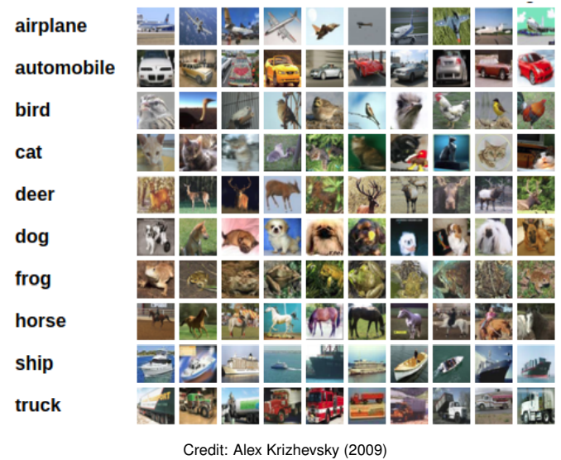
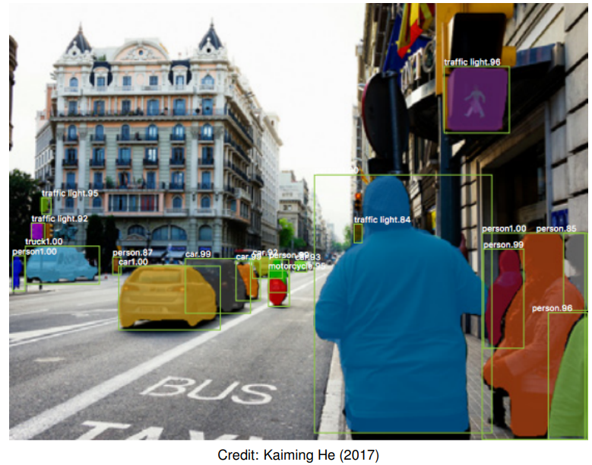
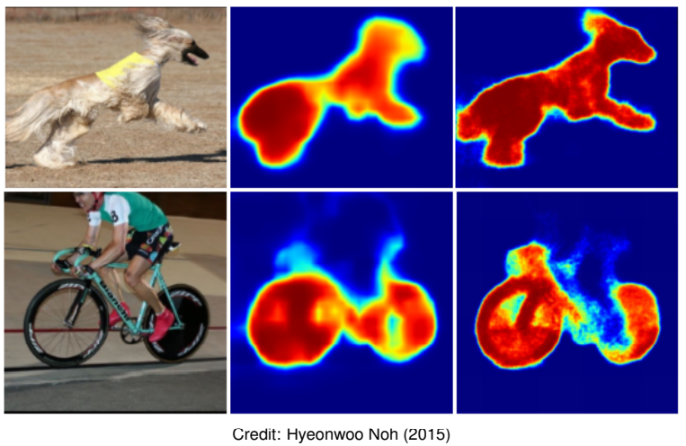
Computer Vision Tasks
Object Classification: What broad category of object is in this photograph?
Object Identification: Which type of a given object is in this photograph?
Object Verification: Is the object in the photograph?
Object Detection: Where are the objects in the photograph?
Object Landmark Detection: What are the key points for the object in the photograph?
Object Segmentation: What pixels belong to the object in the image?
Object Recognition: What objects are in this photograph and where are they?
Image classification: predict a single label for each image
Object detection: generate bounding boxes for each instance
Instance segmentation: partition the image into segments

Slide 7
Computer Vision Algorithms & Methods
Nowadays there are 2 main algorithms dominating the computer vision field, both deep-learning based:
Convolutional Neural Networks
Vision Transformers
Transfer learning and self-supervised learning (particularly contrastive learning) are key methods to reach success in computer vision tasks.
Transfer learning: Transfer learning is a machine learning technique where a model trained on one task is re-purposed on a second related task.
Self-supervised learning: A form of unsupervised learning where the data provides the supervision
Contrastive learning: Contrastive learning is a machine learning technique used to learn the general features of a dataset without labels by teaching the model which data points are similar or different (very good article: https://towardsdatascience.com/understanding-contrastive-learning-d5b19fd96607)
ImageNet is the biggest labeled image database with approx. 15 million images of 21,000 classes (labeled through 49,000 Amazon Mechanical Turk workers) -> https://www.image-net.org/
This resource is very often used for pre-training computer vision models (transfer learning)

Slide 8
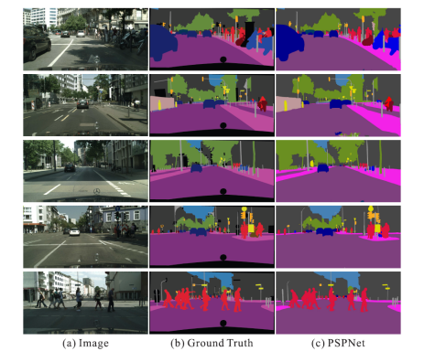
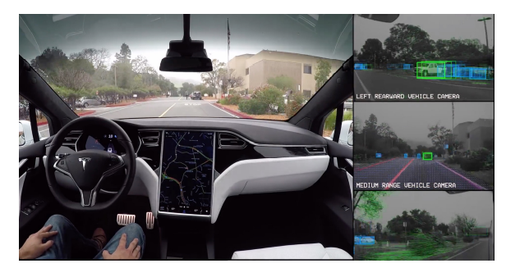
Computer Vision Example Applications
Figure: All Tesla cars being produced now have full self-driving hardware (Source: Tesla website). A convolutional neural network is used to map raw pixels from a single front-facing camera directly into steering commands. The system learns to drive in traffic, on local roads, with or without lane markings as well as on highways.
Figure: Given an input image, a CNN is first used to get the feature map of the last convolutional layer, then a pyramid parsing module is applied to harvest different sub-region representations, followed by upsampling and concatenation layers to form the final feature representation, which carries both local and global context information. Finally, the representation is fed into a convolution layer to get the final per-pixel prediction. (Source: pyramid scene parsing network, by Zhao et. al, CVPR 2017)

Slide 9
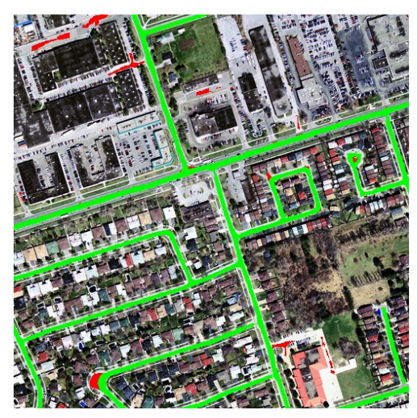
Computer Vision Example Applications
Figure: Road segmentation (Mnih Volodymyr (2013)). Aerial images and possibly outdated map pixels are segmented.

Slide 10
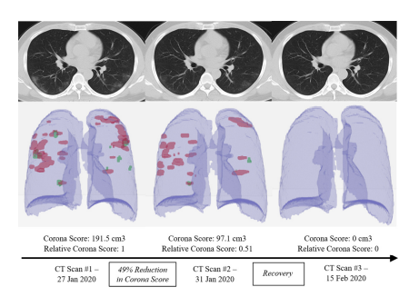
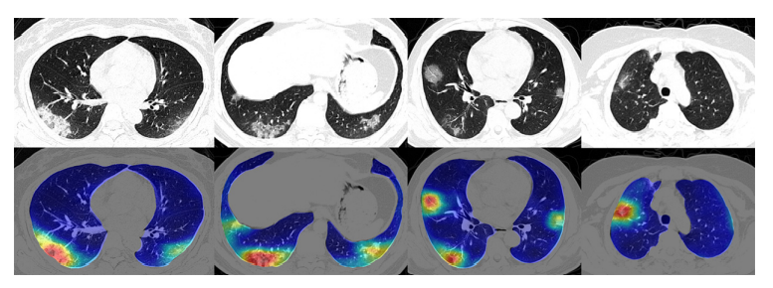
Computer Vision Example Applications
Figure: Four COVID-19 lung CT scans at the top with corresponding colored maps showing Corona virus abnormalities at the bottom (Source: Megan Scudellari, IEEE Spectrum 2021).
Figure: CNN based method (RADLogists) for personalized Covid-19 detection: three CT scans from a single Corona virus patient diagnosed by RADLogists

Slide 11
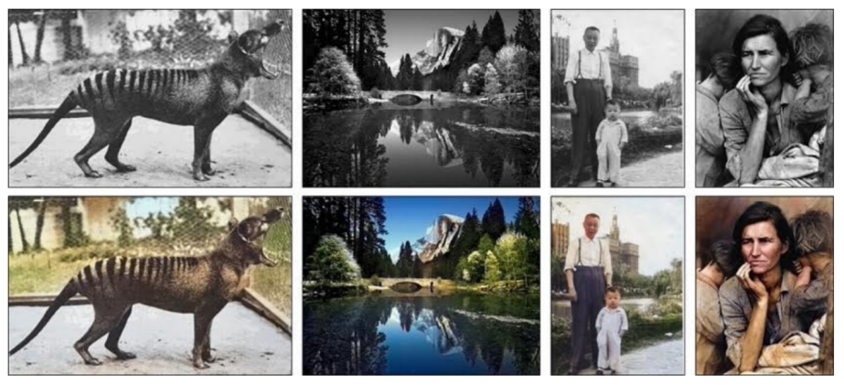
Computer Vision Example Applications
Figure: Image Colorization is another interesting application of CNN in computer vision (Zhang et al. (2016)). Given a grayscale photo as the input (top row), this network solves the problem of hallucinating a plausible color version of the photo (bottom row, i.e. the prediction of the network).

Slide 12
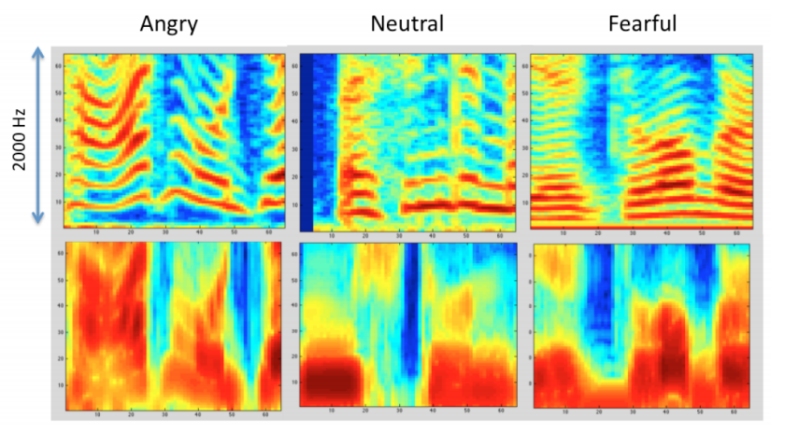
Computer Vision Example Applications
Figure: Speech recognition (Anand & Verma (2015)). Convolutional neural network is used to learn features from the audio data in order to classify emotions

Slide 13
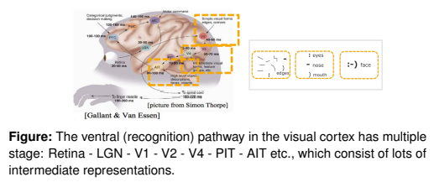
Recap: Convolutional Neural Networks
Convolutional Neural Networks (CNNs, or ConvNets) are a powerful family of neural network architectures in which the connectivity pattern between neurons resembles the organization of the mammal visual cortex.
Basic idea: a CNN automatically extracts visual, or, more generally, spatial features from the input data such that it is able to make the optimal prediction based on the extracted features.

Slide 14
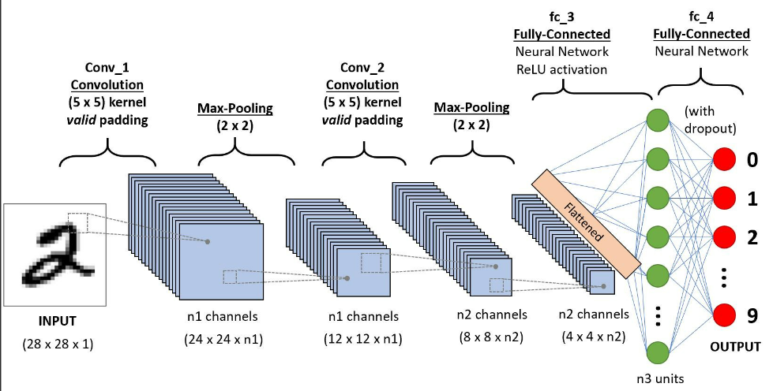
Recap: Convolutional Neural Networks
Input layer takes input data (e.g. image).
Convolution layers extract feature maps from the previous layers.
Pooling layers reduce the dimensionality of feature maps and filter meaningful features.

Slide 15
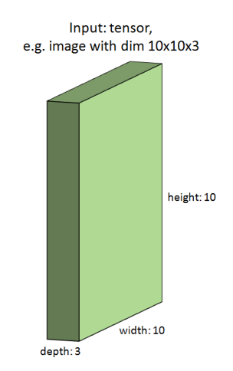
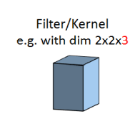
Convolutional Neural Networks
Notes:
- Nice to work together in a bigger team of data science enthusiasts

Slide 16
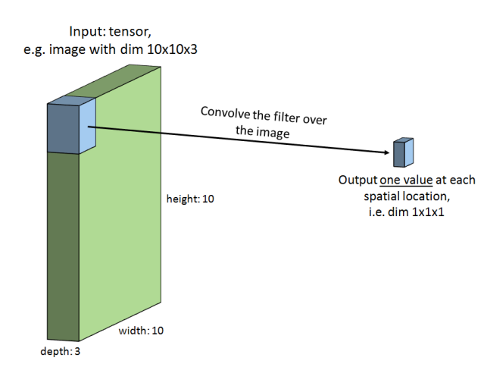
Convolutional Neural Networks
Notes:
- Nice to work together in a bigger team of data science enthusiasts

Slide 17
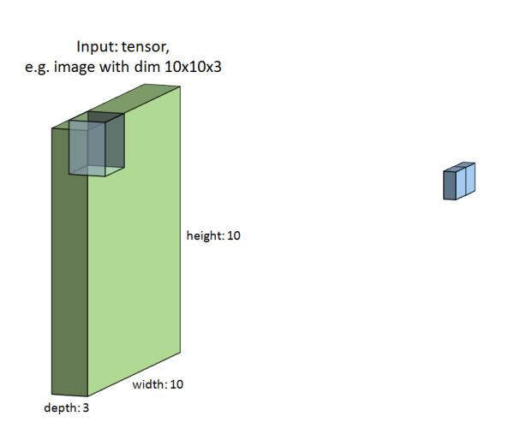
Convolutional Neural Networks
Notes:
- Nice to work together in a bigger team of data science enthusiasts

Slide 18
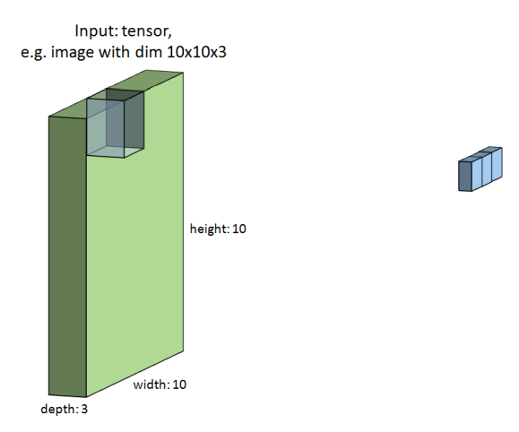
Convolutional Neural Networks
Notes:
- Nice to work together in a bigger team of data science enthusiasts

Slide 19
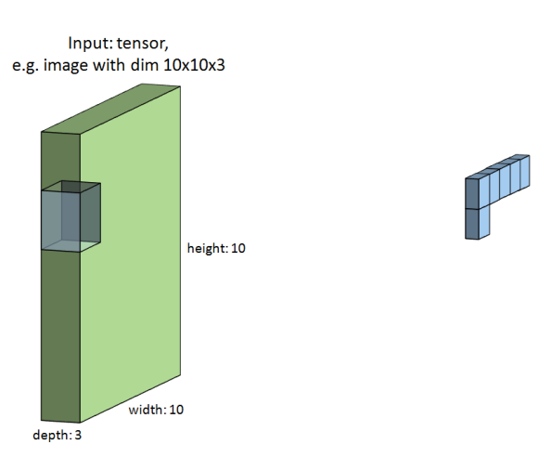
Convolutional Neural Networks
Notes:
- Nice to work together in a bigger team of data science enthusiasts

Slide 20
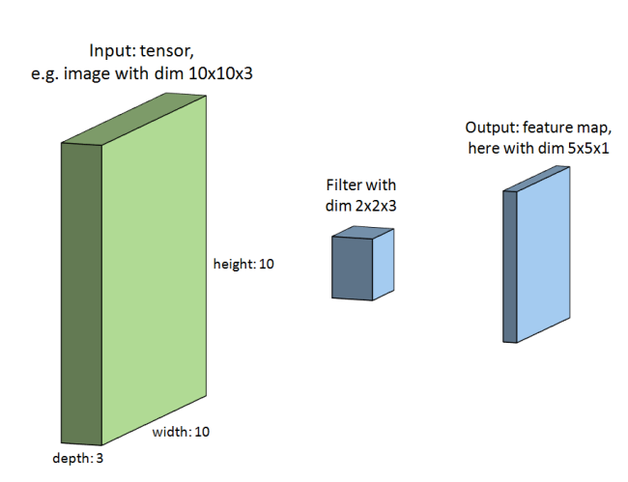
Convolutional Neural Networks
Notes:
- Nice to work together in a bigger team of data science enthusiasts

Slide 21
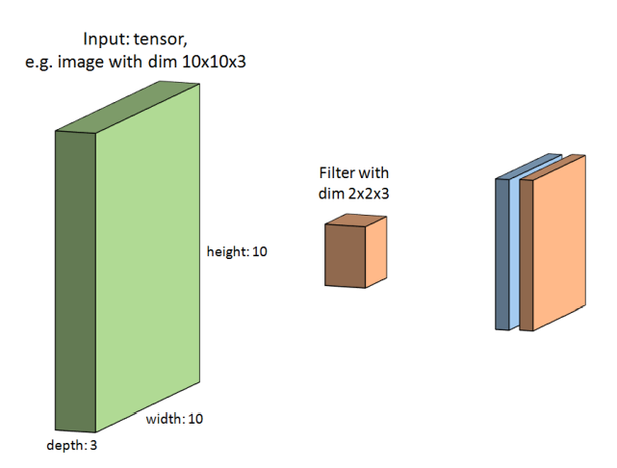
Convolutional Neural Networks
Notes:
- Nice to work together in a bigger team of data science enthusiasts

Slide 22
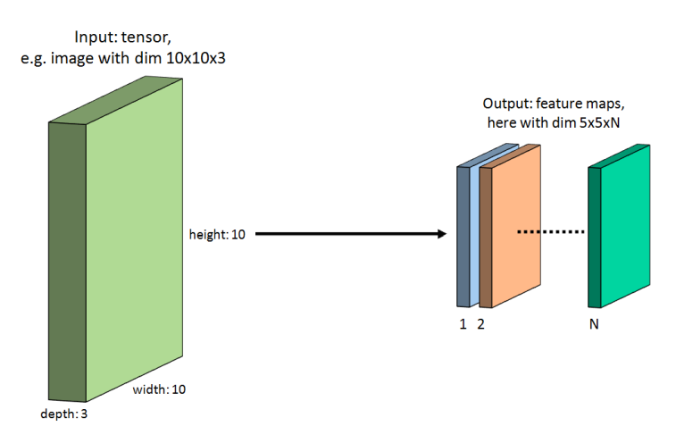
Convolutional Neural Networks
Notes:
- Nice to work together in a bigger team of data science enthusiasts

Slide 23
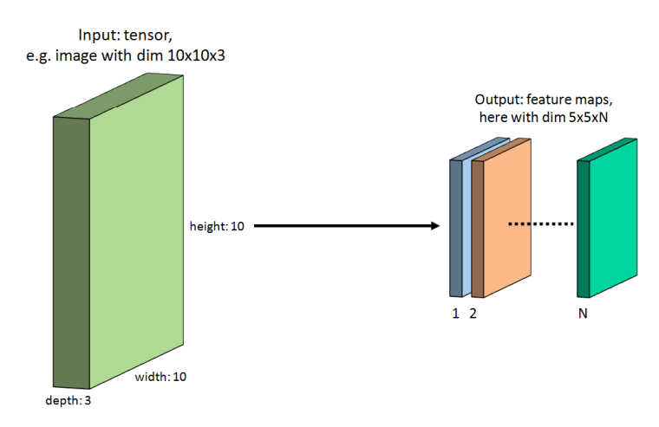
Convolutional Neural Networks
Notes:
- Nice to work together in a bigger team of data science enthusiasts

Slide 24
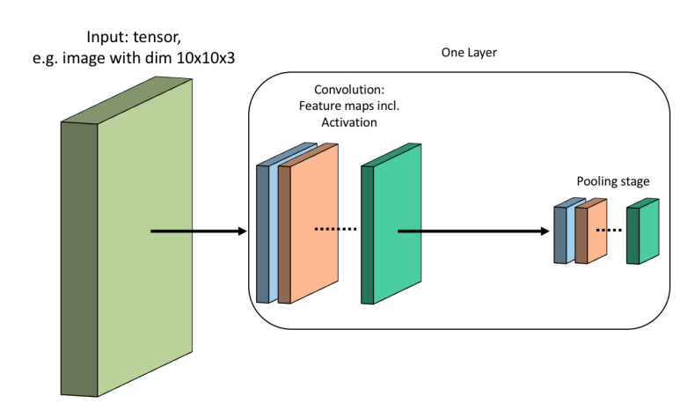
Convolutional Neural Networks
Notes:
- Nice to work together in a bigger team of data science enthusiasts

Slide 25
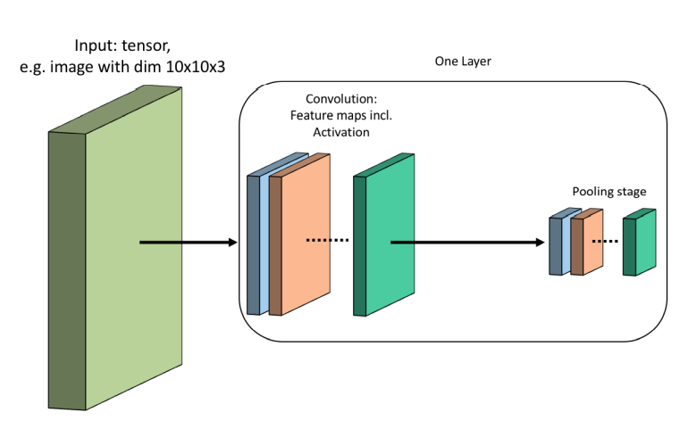
Convolutional Neural Networks
Notes:
- Nice to work together in a bigger team of data science enthusiasts

Slide 26
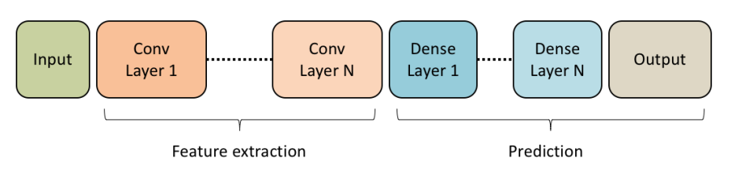
Convolutional Neural Networks
Many of these layers can be placed successively, to extract even more complex features.
Notes:
- Nice to work together in a bigger team of data science enthusiasts

Slide 27
Natural Language Processing (NLP)
xx

Slide 28
Graph Neural Networks (GNNs)
xx

Slide 29
Recommender Systems
xx

Slide 30
Generative Adversarial Networks (GANs)
xx

Slide 31
Deep Reinforcement Learning
xx

Slide 32
Model Interpretability
xx

